Slide 1
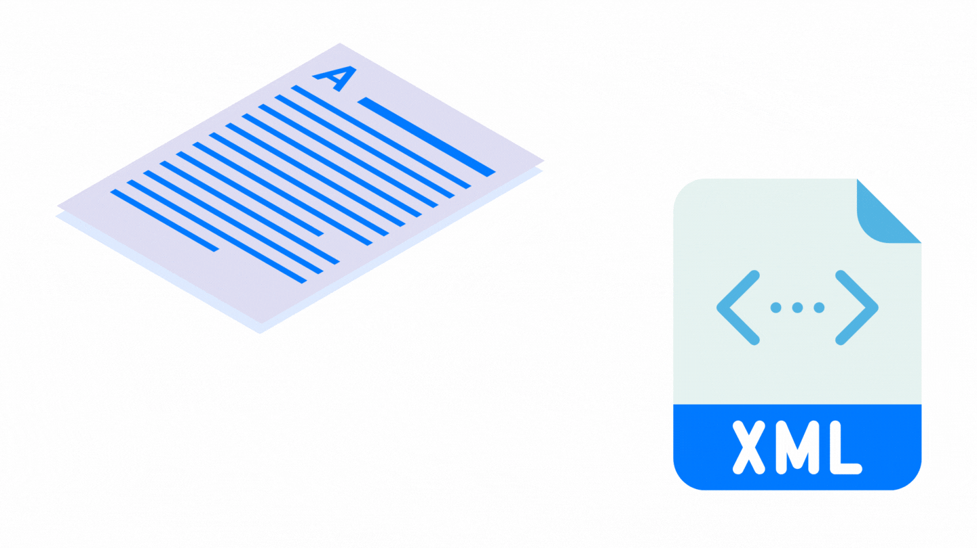

EXTENSIBLE MARKUP LANGUAGE
ABDUL WAHAB AMIR

Slide 2

LOOK AT THE MESSAGE CAREFULLY
SIMPLE EXCHANGE OF DATA BETWEEN TWO
USERS , A CONVERSATION IN WHICH YOU WILL
TELL ABOUT YOUR FRIENDS AND BEST FRIENDS

Slide 3


THIS MESSAGE IS SUITABLE WHEN TWO PEOPLE ARE TALKING TO EACH OTHER
IT WILL WORK WHEN TWO USERS ARE HAVIGN A
CONVERSATION WITH EACH OTHER

Slide 4


BUT WHEN TWO MACHINES TALKS TO EACH OTHER 🤔
HOWEVER IF TWO MACHINES AND TWO APP HAVE TO
TALK TO EACH OTHER OR EXCHANGE DATA , THIS WAY
OR THIS TYPE OF FORMATING WILL NOT WORK
WE NEED A MORE STRUCTURED AND MORE FORMATTED
WAY TO EXCHAGE DATA

Slide 5
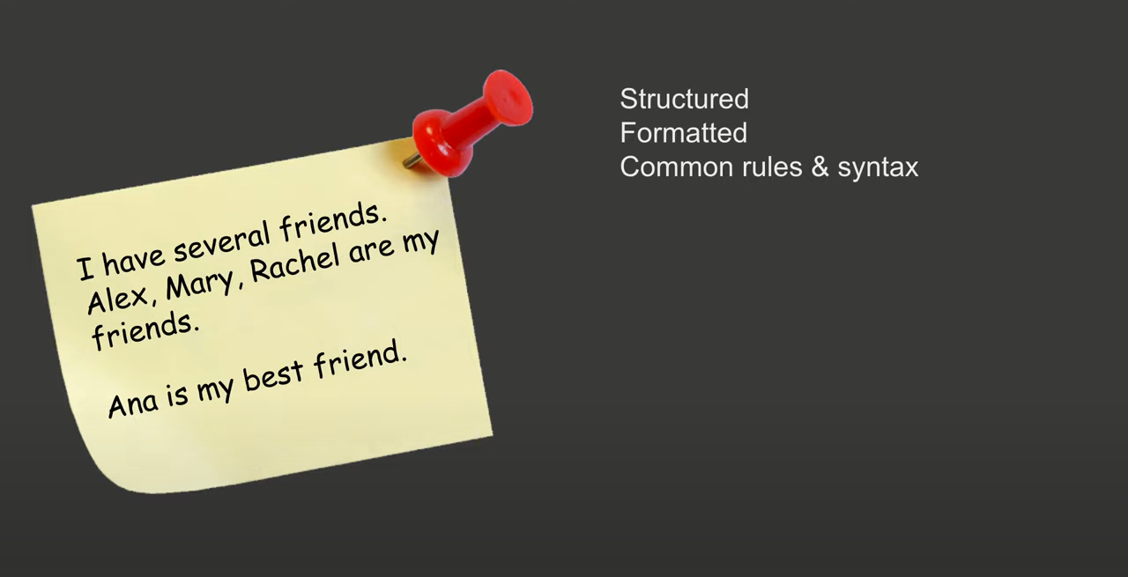
BUT WHEN TWO MACHINES TALKS TO EACH OTHER 🤔
SO , WE WILL NOW , CONVERT THIS MESSAGE TO A
WELL STRUCTURES AND FORMATED WAY.

Slide 6

A STRUCTURED , FORMATTED WAY IS REQUIRED

Slide 7

A STRUCTURED , FORMATTED WAY IS REQUIRED

Slide 8
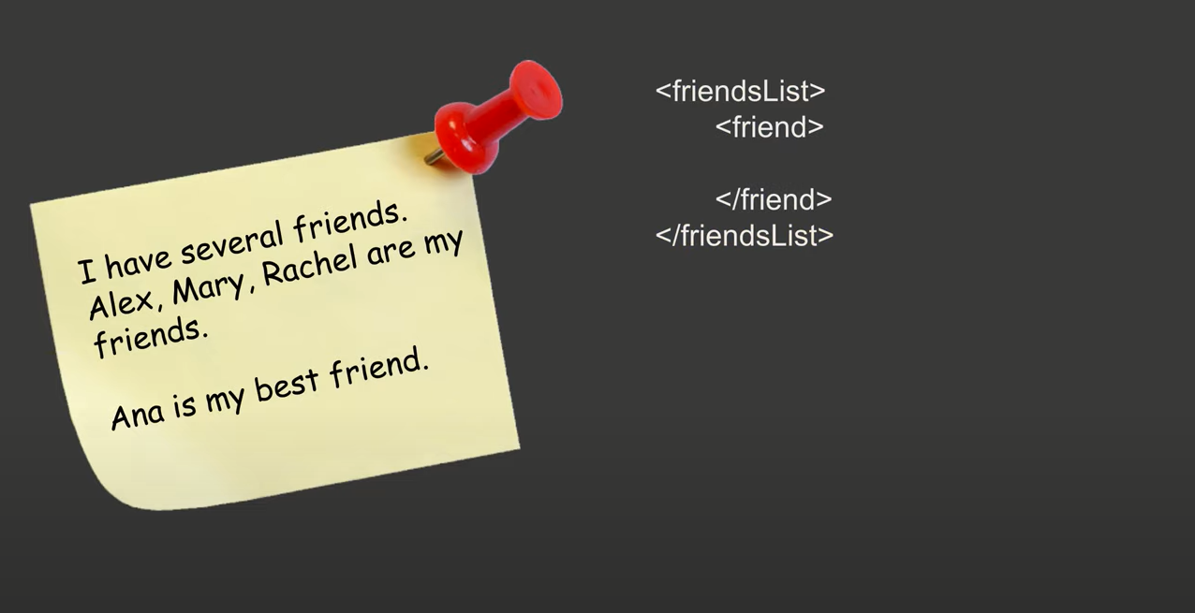
A STRUCTURED , FORMATTED WAY IS REQUIRED

Slide 9

A STRUCTURED , FORMATTED WAY IS REQUIRED

Slide 10
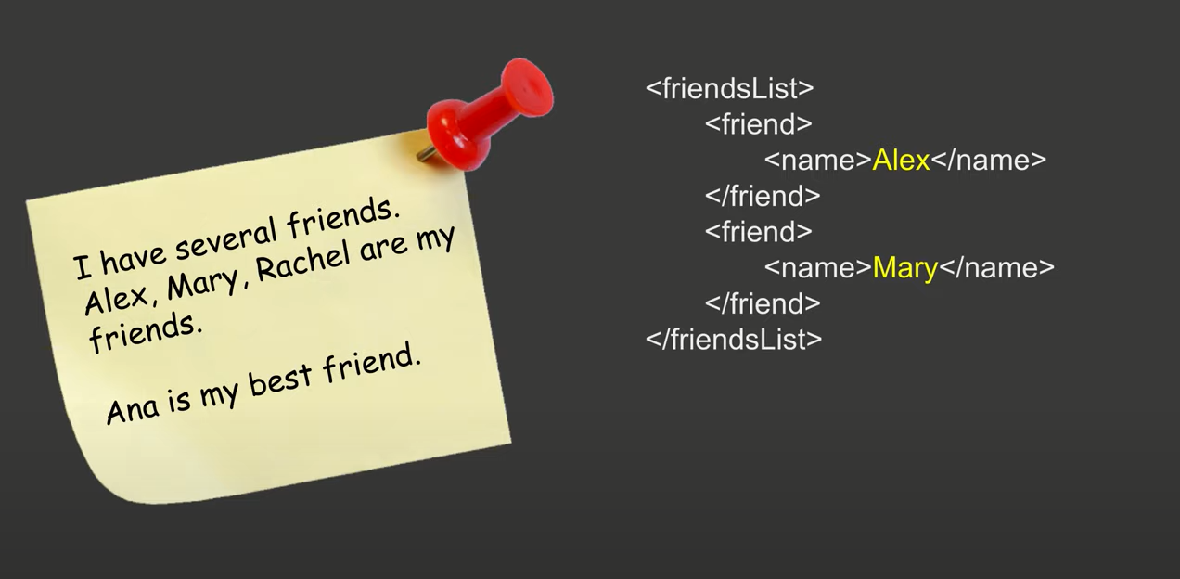
A STRUCTURED , FORMATTED WAY IS REQUIRED

Slide 11
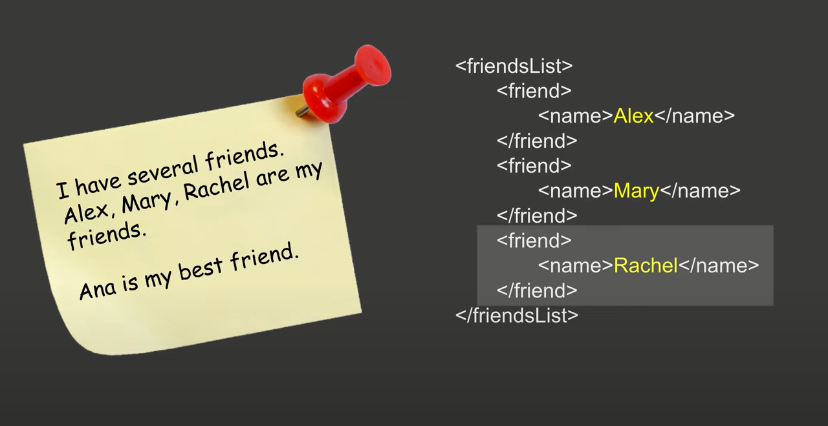
A STRUCTURED , FORMATTED WAY IS REQUIRED

Slide 12
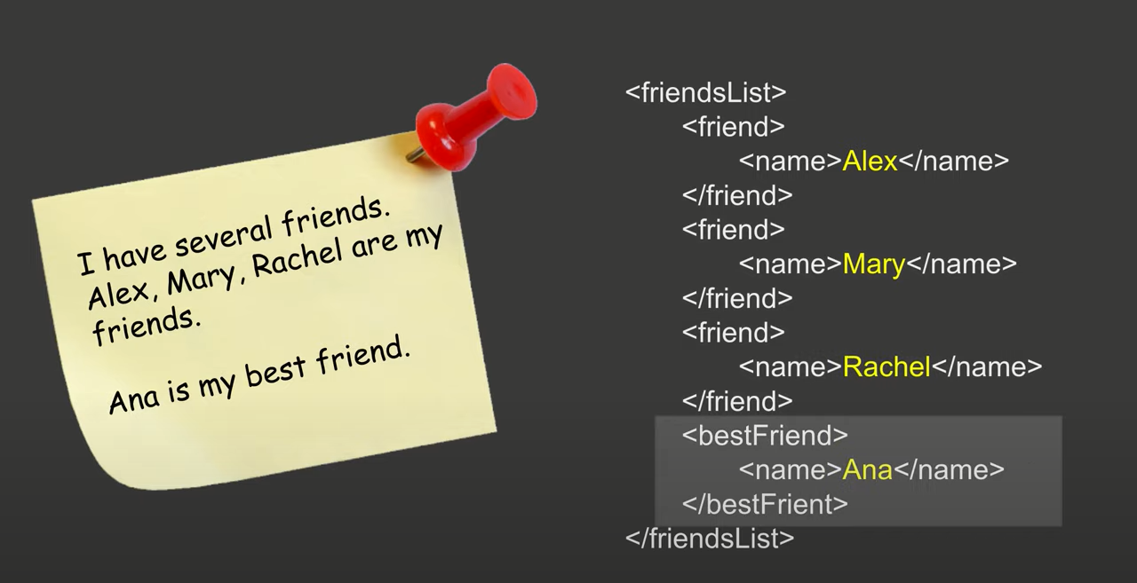
A STRUCTURED , FORMATTED WAY IS REQUIRED

Slide 13
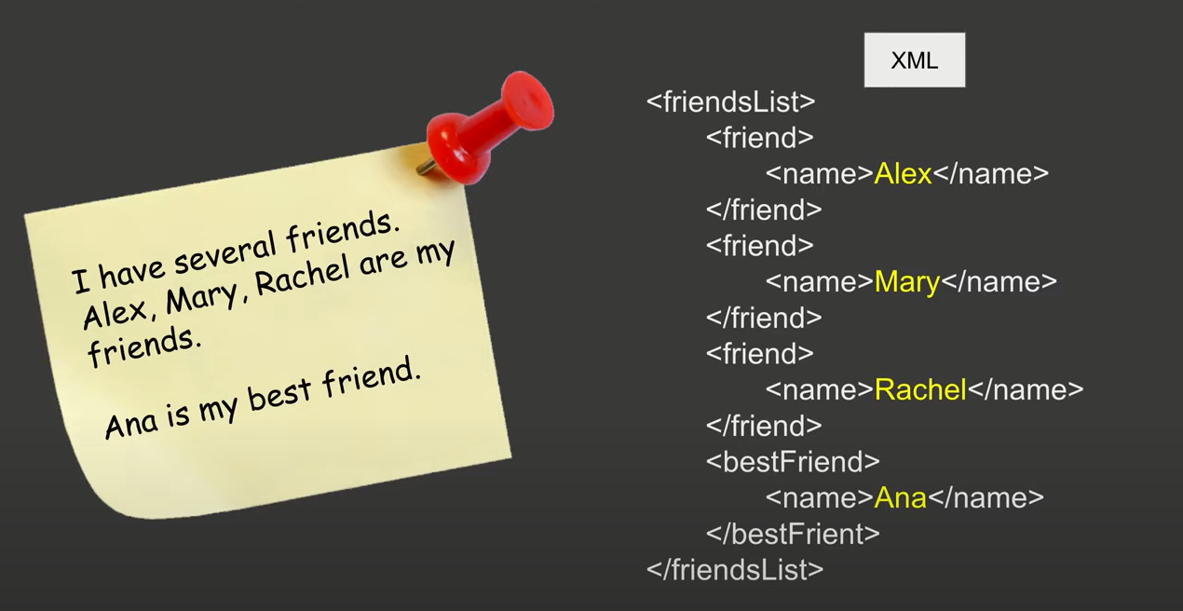
A STRUCTURED , FORMATTED WAY IS REQUIRED

Slide 14
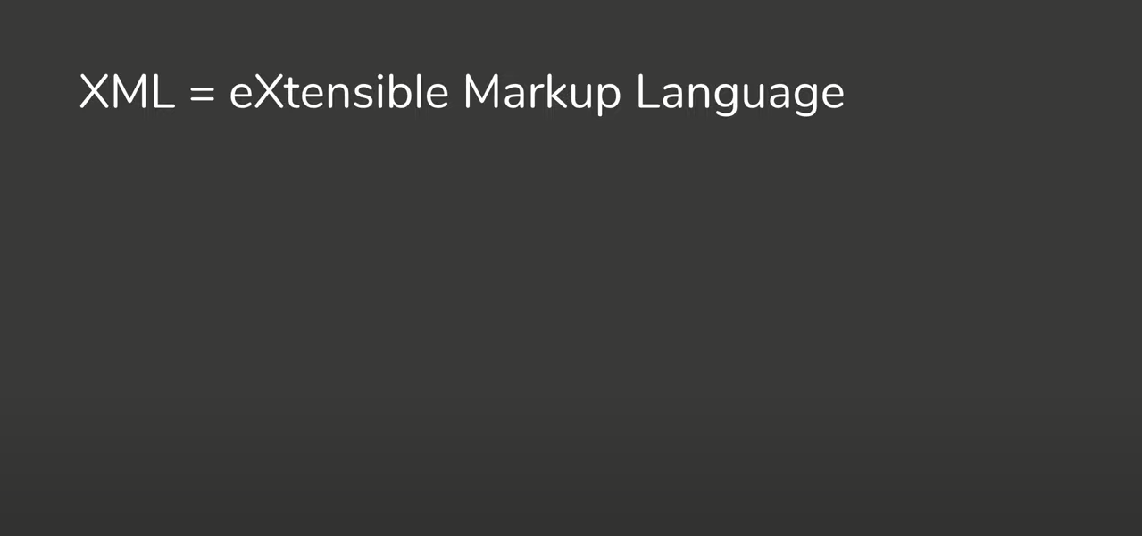
SO, WHAT IS XML ?

Slide 15
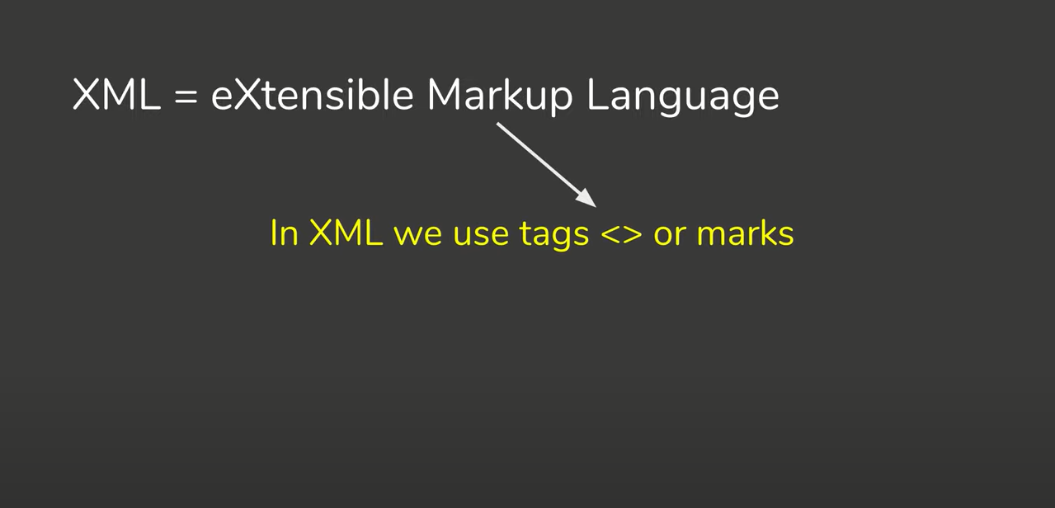
SO, WHAT IS XML ?

Slide 16
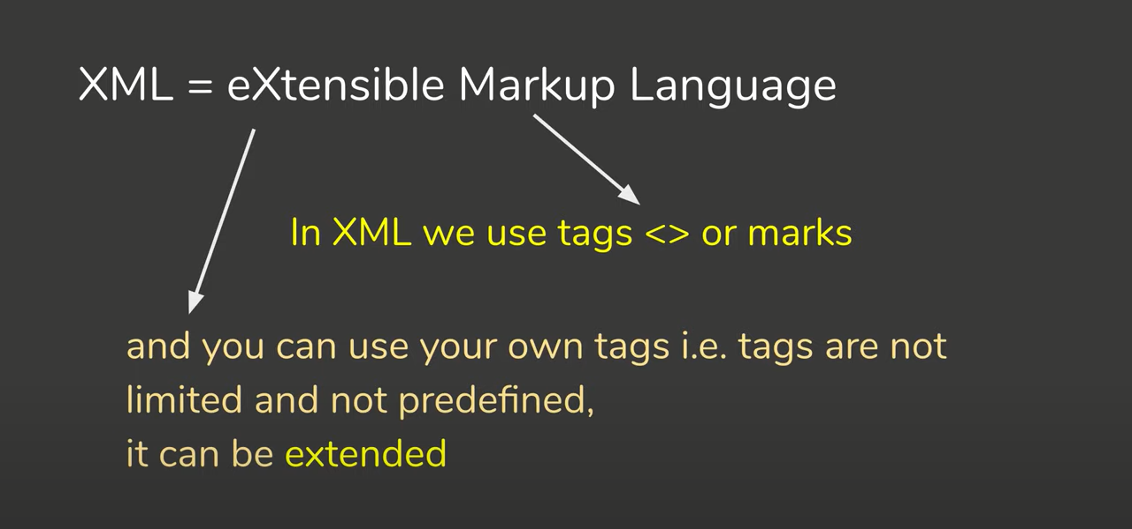
SO, WHAT IS XML ?

Slide 17
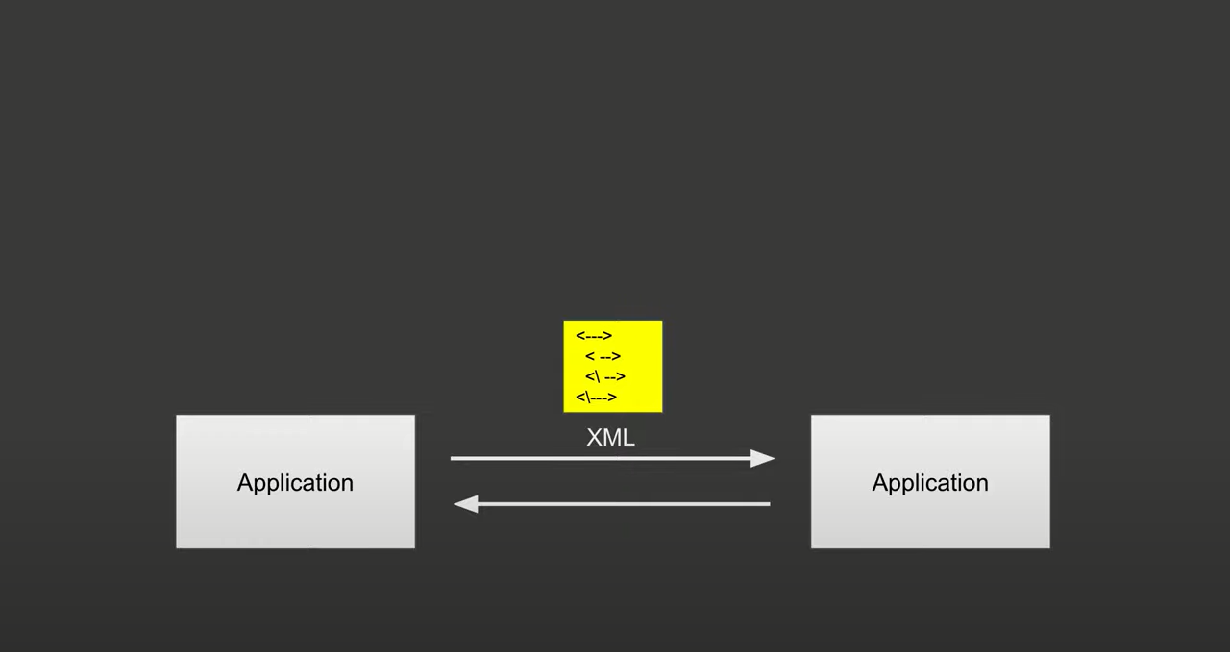
ROLE OF XML , BETWEEN TWO APPLICATION

Slide 18
ROLE OF XML , BETWEEN TWO APPLICATION

Slide 19
ROLE OF XML , BETWEEN TWO APPLICATION

Slide 20
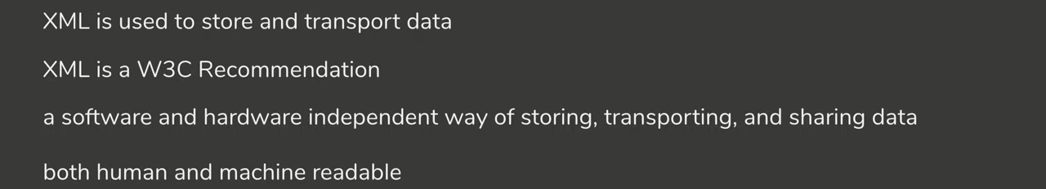
ROLE OF XML , BETWEEN TWO APPLICATION

Slide 21
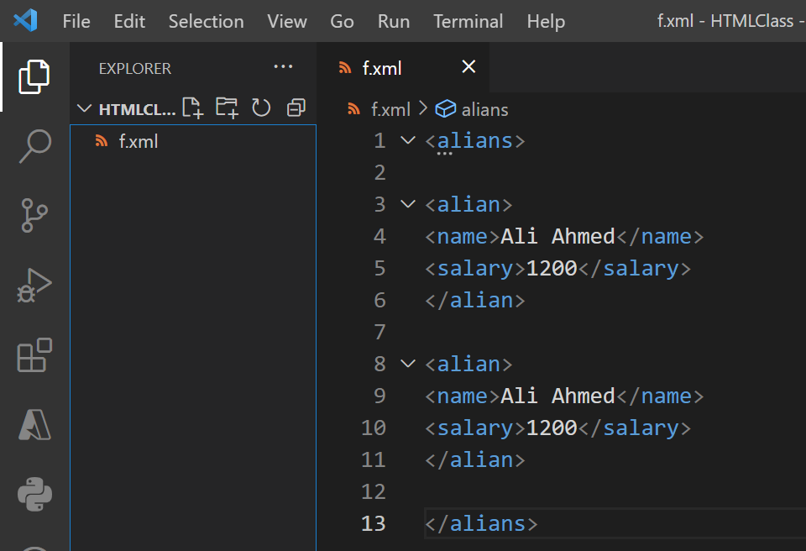
A SIMPLE XML FILE , HAVING A ALIANS DATA

Slide 22
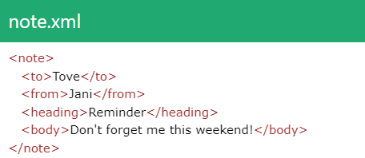
A SIMPLE XML FORMAT , A NOTE MESSAGE

Slide 23
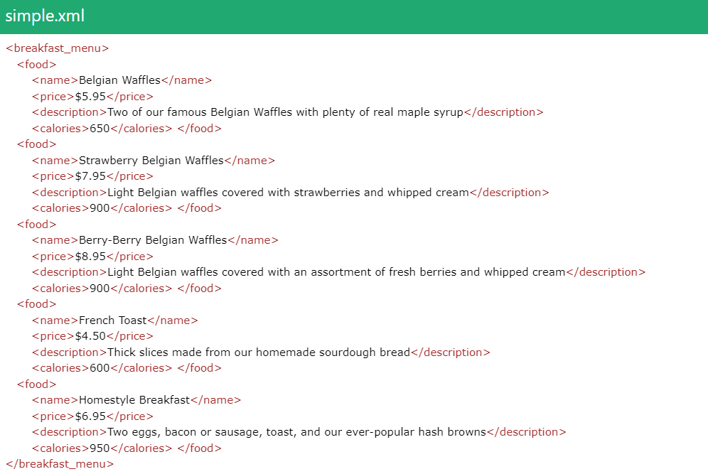
A SIMPLE XML FORMAT , A DATA REPRESENTS BREAKFAST MENU

Slide 24



THANK YOU
ABDUL WAHAB AMIR
MY GITHUB: HTTPS://GITHUB.COM/A-WAHAB-AAMIR​
ABDUL0999.NETLIFY.APP| APTECH LEARNING

Slide 25
SOMETHING MORE ABOUT XML
XML stands for eXtensible Markup Language. It is a language (not> a programming language) that uses the markup and can extend. It is derived from Standard Generalized Markup Language(SGML). XML also uses DTDs (Document Type Definitions) to define the XML document structure.

Slide 26
THREE IMPORTANT CHARACTERISTICS OF XML
XML is extensible − XML allows you to create your own self-descriptive tags, or language, that suits your application.
XML carries the data, does not present it − XML allows you to store the data irrespective of how it will be presented.
XML is a public standard − XML was developed by an organization called the World Wide Web Consortium (W3C) and is available as an open standard.

Slide 27
IS XML A PROGRAMMING LANGUAGE?
A programming language consists of grammar rules and its own vocabulary which is used to create computer programs. These programs instruct the computer to perform specific tasks. XML does not qualify to be a programming language as it does not perform any computation or algorithms. It is usually stored in a simple text file and is processed by special software that is capable of interpreting XML

Slide 28
HISTORY OF XML
XML started way back in 1996 and was first published in 1998. World Wide Web Consortium (W3C) is the developer of XML, and it became a W3C recommendation in 1998.
There are two versions of XML.
XML 1.0
XML 1.1
XML 1.1 is the latest version. Yet, XML 1.0 is the most used version.

Slide 29
XML ENCODING
Encoding is the conversion of Unicode characters to their binary representation. UTF is use for XML encoding. UTF stands for UCS (UCS stands for Universal Character Set) Transformation Format.
Mainly, there are two types of UTF encoding.
UTF-8 : UTF-8 uses 8-bits to represent the characters.
UTF-16 It uses 16-bits to represent the characters.

Slide 30

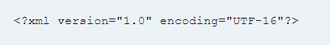
XML ENCODING
UTF-8 : UTF-8 uses 8-bits to represent the characters.
UTF-16 It uses 16-bits to represent the characters.
UTF-8 is the default encoding in XML.

Slide 31
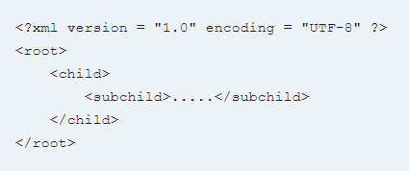
XML SYNTEXT

Slide 32

XML COMMENTS
A comment begins with <!– and ends with –>.

Slide 33
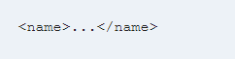
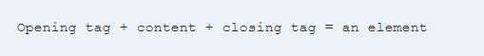
XML TAG AND ELEMENTS
Every tag pair consists of an opening tag (also known as the start tag) and a closing tag (also known as the end tag).

Slide 34
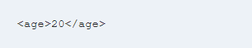
XML TAG AND ELEMENTS
Let us consider the given element
age is the name of the element.
<age> – opening tag
25 – content
</age> – closing tag.
If there is no content between the tags, as shown below, it referred to as empty tags.

Slide 35

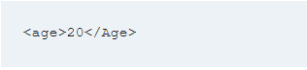
XML TAG AND ELEMENTS RULES
Let us consider the given element
AGE, Age, and age are three different names in XML.

Slide 36
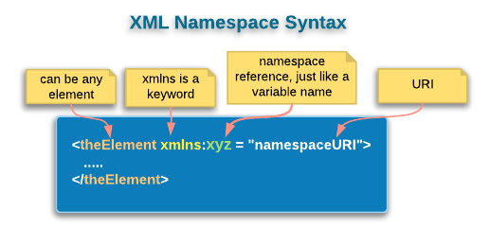

Slide 37
XML NAMESPACE
XML Namespace is used to avoid element name conflict in XML document.
A Namespace is a set of unique names. Namespace is a mechanisms by which element and attribute name can be assigned to a group. The Namespace is identified by URI(Uniform Resource Identifiers).

Slide 38
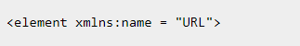
XML NAMESPACE DECLARATION
A Namespace is declared using reserved attributes. Such an attribute name must either be xmlns or begin with xmlns: shown as below −

Slide 39
XML SYNTEXT
The Namespace starts with the keyword xmlns.
The word name is the Namespace prefix.
The URL is the Namespace identifier. {Uniform Resource Identifier (URI)}

Slide 40
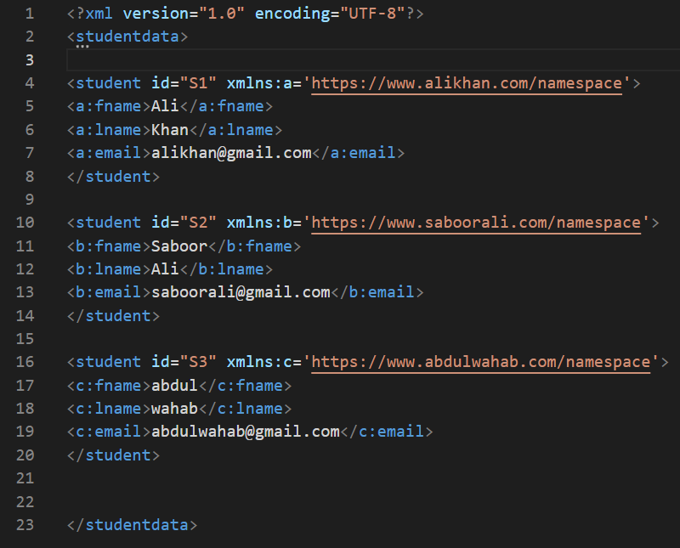
XML SYNTEXT

Slide 41
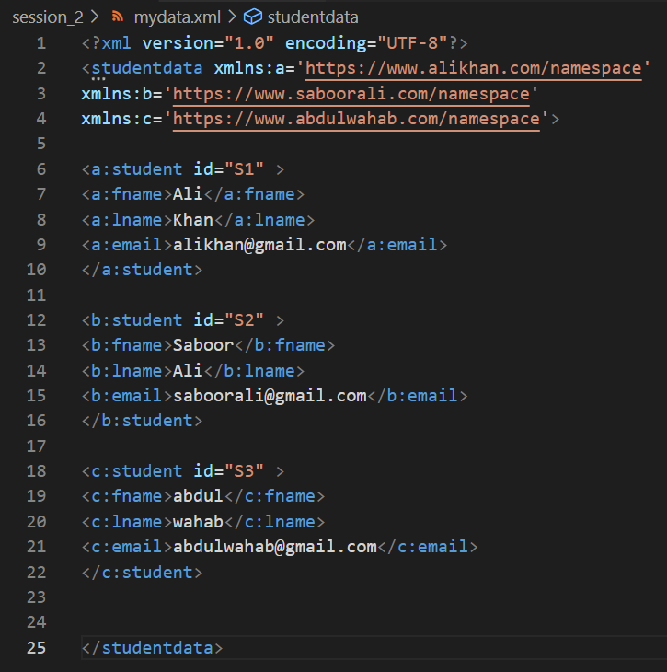
XML SYNTEXT
You can declare the namespace
In root element

Slide 42
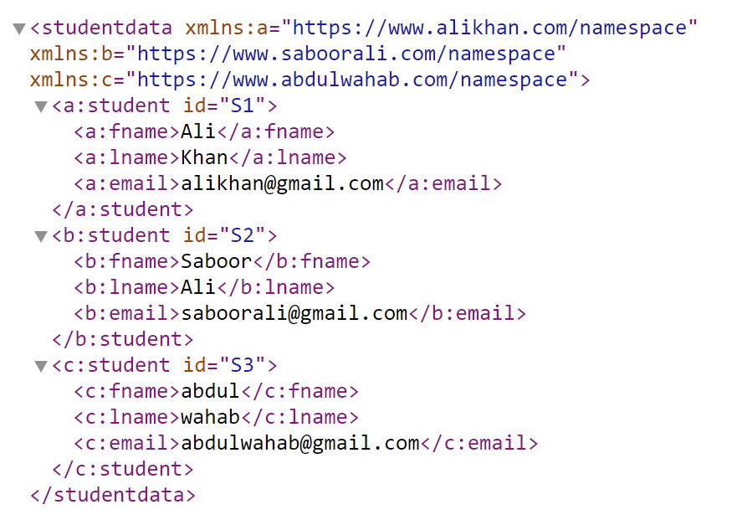
XML OUTPUT

Slide 43
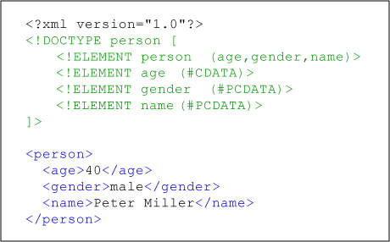
GRAMEER
STRUCTURE ---------------> DTD
CONTENT ------------------->SCHEMA
XML DTD (DOCUMENT TYPE DEFINATION)

Slide 44
XML DTD
The XML Document Type Declaration, commonly known as DTD, is a way to describe XML language precisely.
A DTD defines the structure and the legal elements and attributes of an XML document.

Slide 45
XML DTD PURPOSE
Its main purpose is to define the structure of an XML document. It contains a list of legal elements and define the structure with the help of them.

Slide 46
XML DTD STRUCTURE INCLUDES
List Of Valid Elements,
List Of Valid Attributes,
List Of Entities,
Definition On How Elements Can Be Nested,
Definition Whether An Element Or Attribute Is Required, Recommended Or Optional,
Definition On How Often Elements May Be Used (0, 1 Or More),

Slide 47
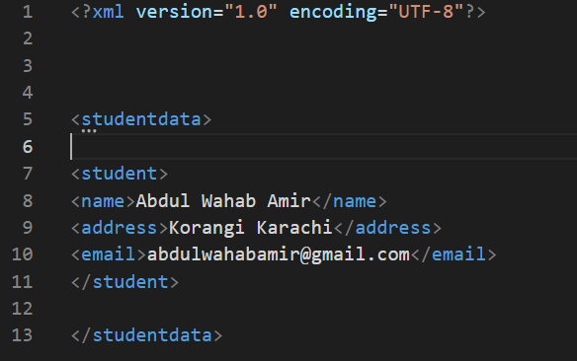
XML DTD STRUCTURE INCLUDES
1)

Slide 48
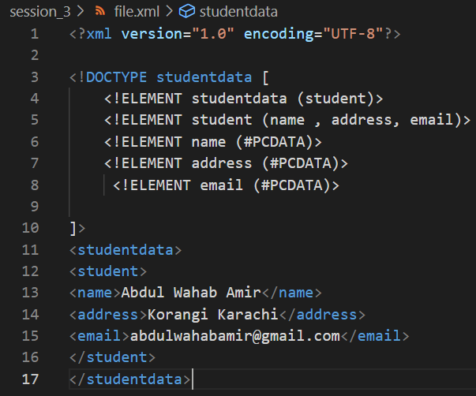
XML DTD STRUCTURE INCLUDES
2)

Slide 49
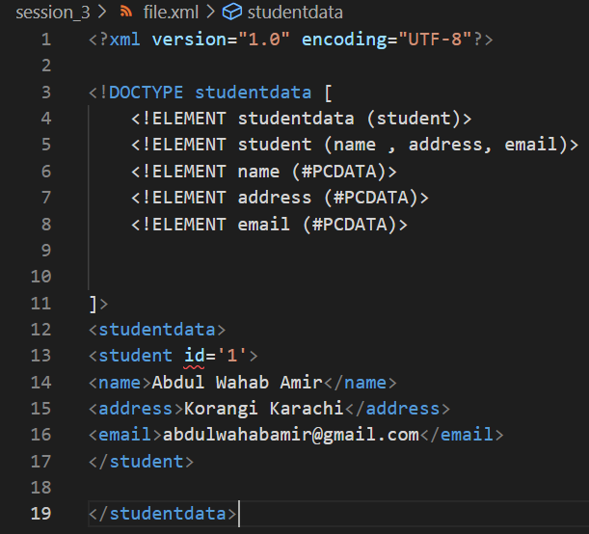
XML DTD STRUCTURE INCLUDES
3)

Slide 50
XML DTD STRUCTURE INCLUDES
4)

Slide 51
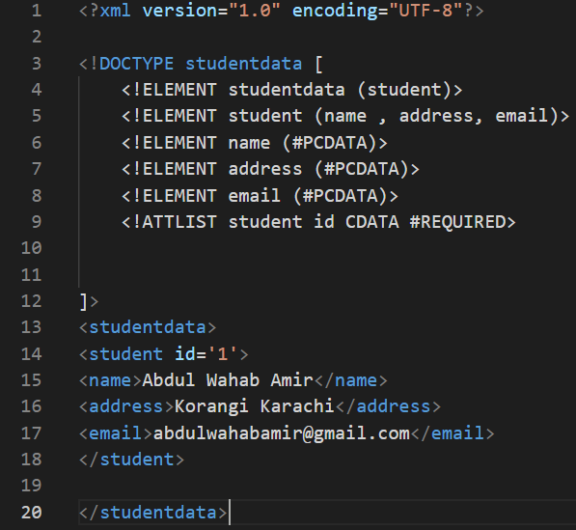
XML DTD STRUCTURE INCLUDES
5)

Slide 52
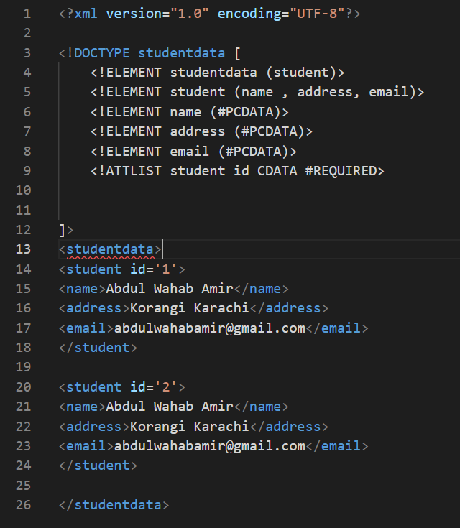
6)
XML (ADDIGN MULTIPLE STUDENT)

Slide 53
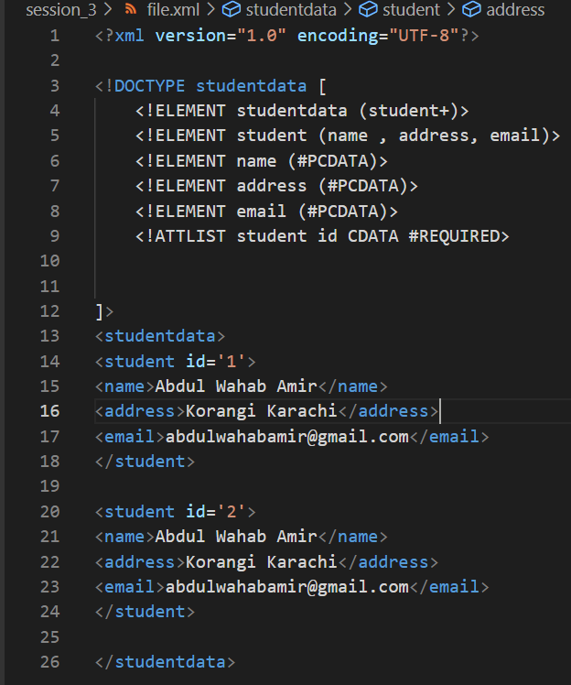
7)
XML INCLUDE + FOR MULTIPLE

Slide 54
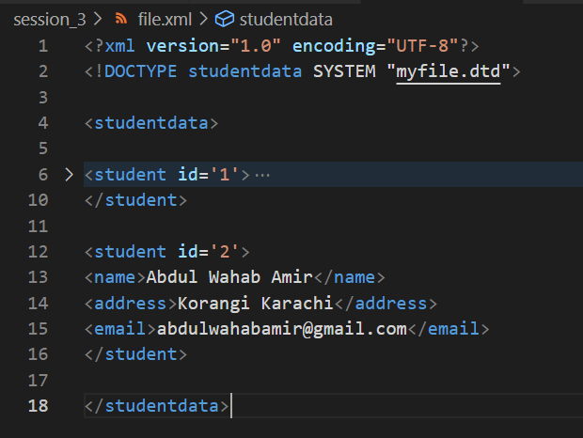
XML (Separate the XML and DTD)
8)

Slide 55
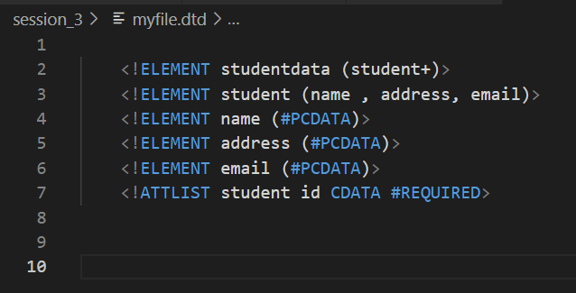
XML (Separate the XML and DTD)
9)

Slide 56
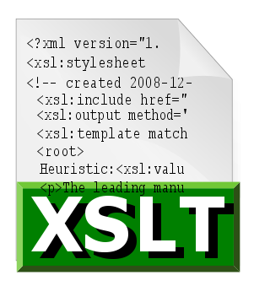
XSLT Introduction

Slide 57
XSLT Introduction
EXtensible Stylesheet Language Transformation commonly known as XSLT is a way to transform the XML document into other formats such as XHTML
XSL (eXtensible Stylesheet Language) is a styling language for XML.
XSLT stands for XSL Transformations.

Slide 58
WHAT IS XSL ?
In HTML documents, tags are predefined but in XML documents, tags are not predefined. World Wide Web Consortium (W3C) developed XSL to understand and style an XML document, which can act as XML based Stylesheet Language.
An XSL document specifies how a browser should render an XML document.

Slide 59
PREREQUISITE
What You Should Already Know
Before you continue you should have a basic understanding of the following:
HTML
XML

Slide 60
ADVANTAGES
XSLT provides an easy way to merge XML data into presentation because it applies user defined transformations to an XML document and the output can be HTML, XML, or any other structured document.
XSLT provides Xpath to locate elements/attribute within an XML document. So it is more convenient way to traverse an XML document rather than a traditional way, by using scripting language.

Slide 61
THANK YOU
ABDUL WAHAB AMIR
MY GITHUB: HTTPS://GITHUB.COM/A-WAHAB-AAMIR​
ABDUL0999.NETLIFY.APP| APTECH LEARNING

